Slide 1

“Average rating’s book predictor”
Project 6
Marisa Fernandes

Slide 2


“Average rating’s book predictor” as a product

Slide 3
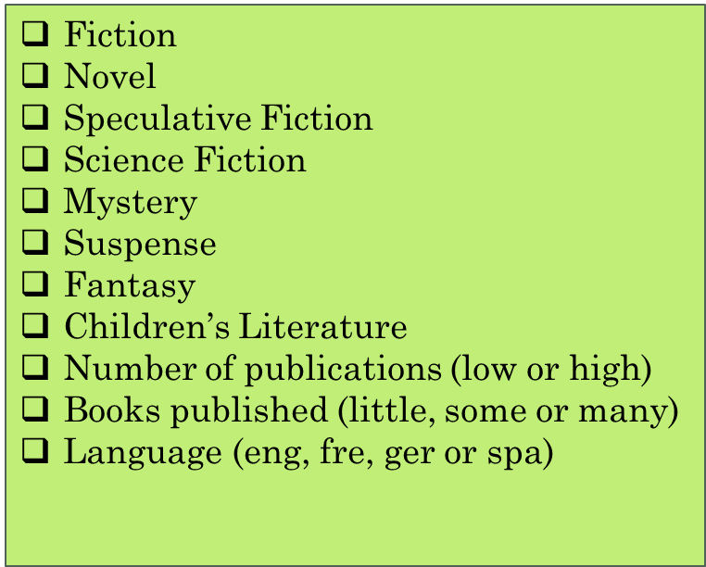
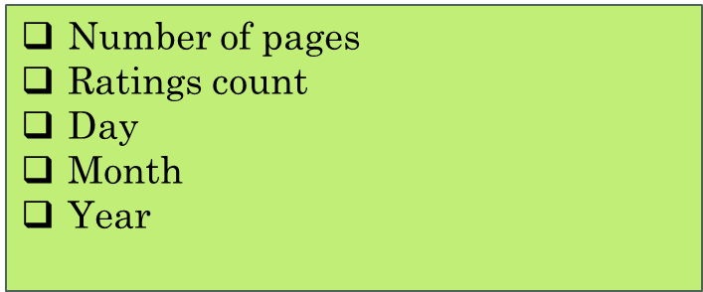
Information to be provided in order to predict

Slide 4
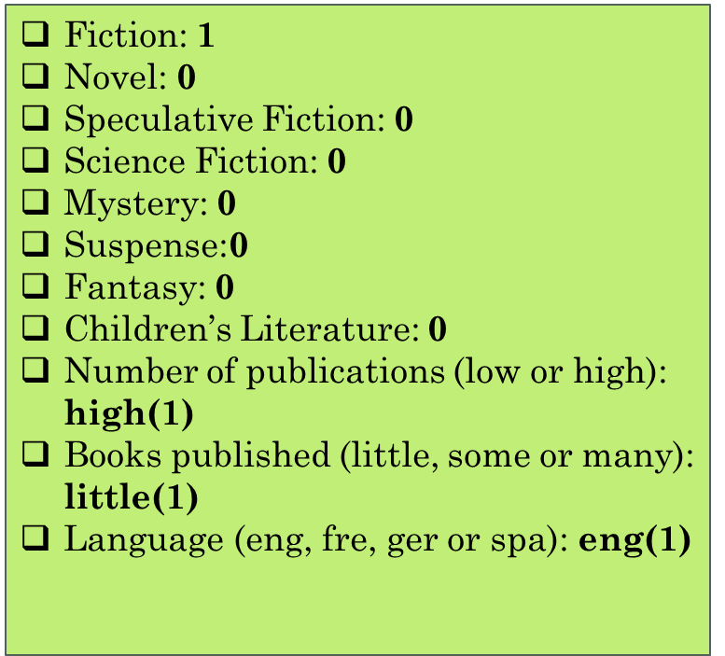
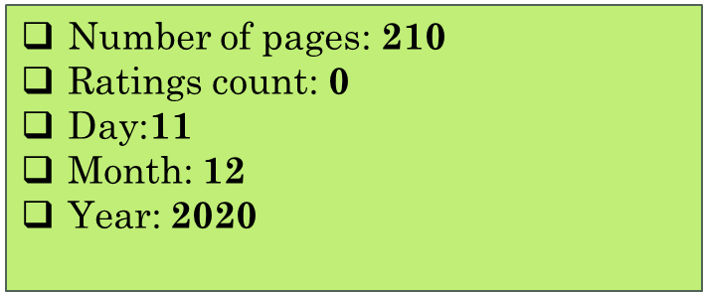
Imagine a book with the following conditions…

Slide 5

What would be its average rating?
4
Classification
1- Did not like it
2- It was ok
3- Liked it
4- Really liked it
5- It was amazing

Slide 6

“Average rating’s book predictor” as a technical challenge

Slide 7
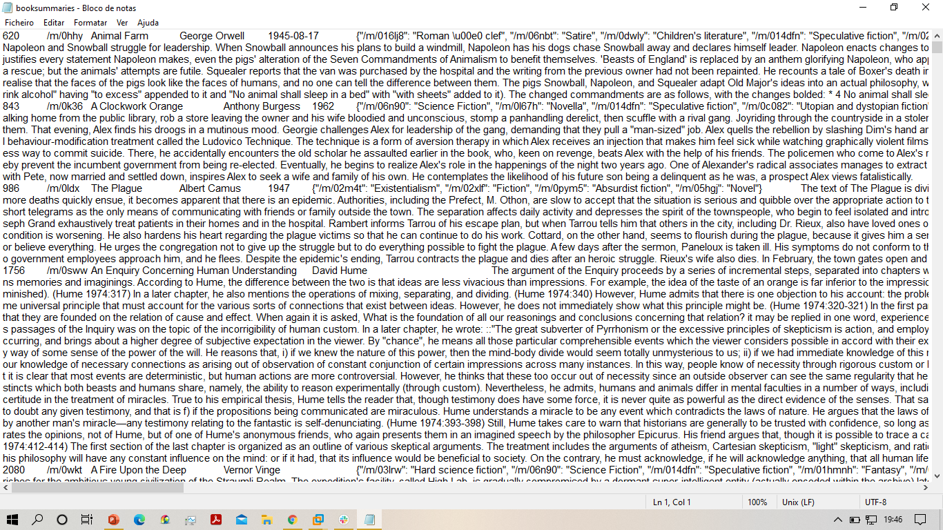
Technical challenges
.txt file to convert into a csv

Slide 8
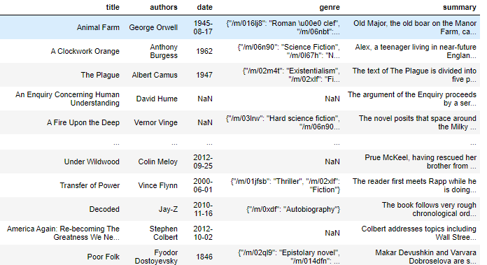
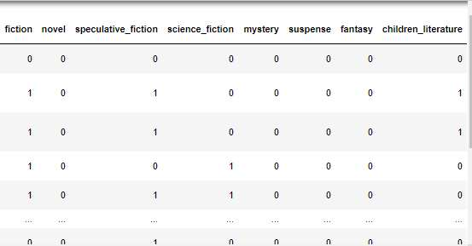
Technical challenges
the column of books’ genre (essential)

Slide 9

Random forest classifier to make the predictions
GridSearch CV
Score: 0.9349593495934959

Slide 10

Future improvements
develop an user friendly interface for introducing book’s data and obtaining the average rating prediction. This will make easier the decision about the publication of a book.

Slide 11
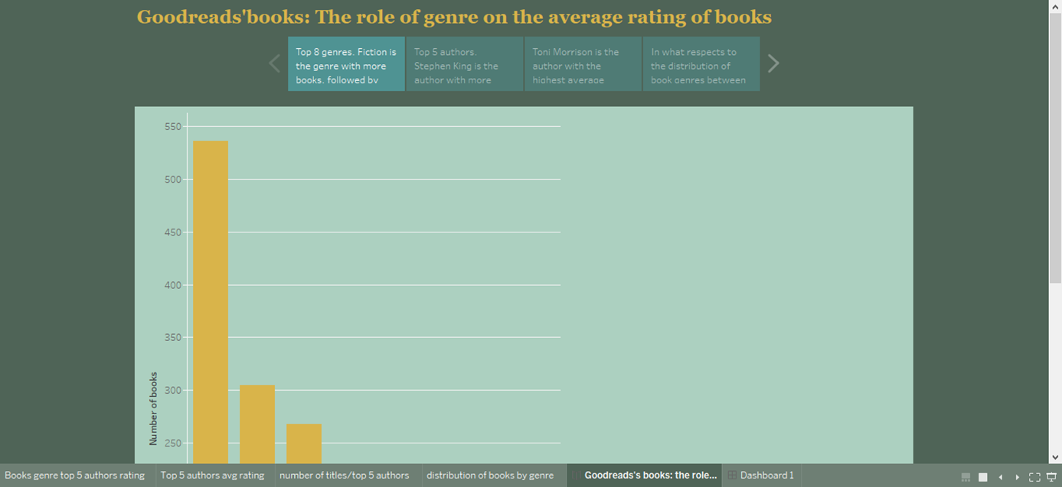
After machine learning and before finishing… let’s present some data analysis conclusions about books’genre!

Slide 12
Thank you!

